Slide 1
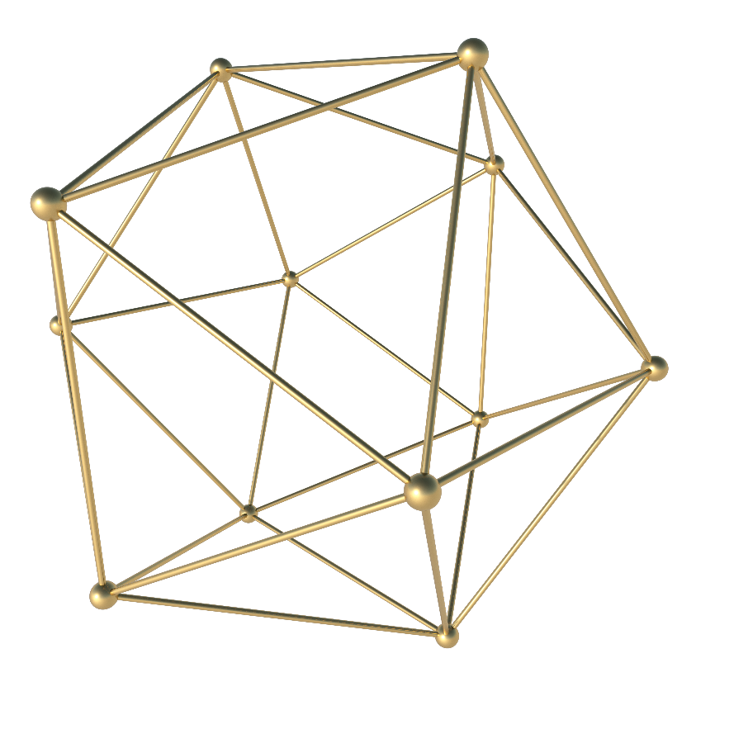

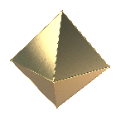

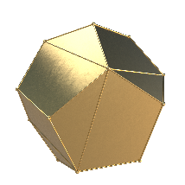


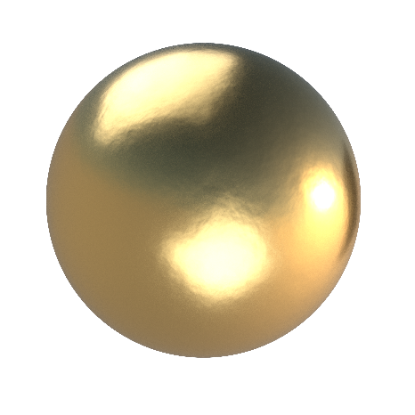
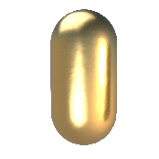
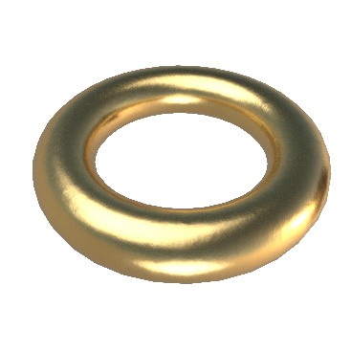
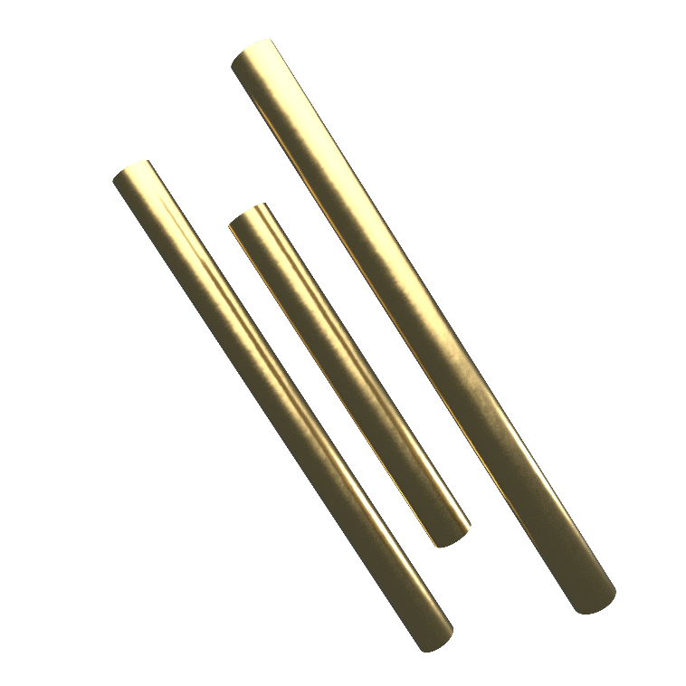
金属
立体三维
| HIGH-RES 3D GOLDEN SHAPE

Slide 2

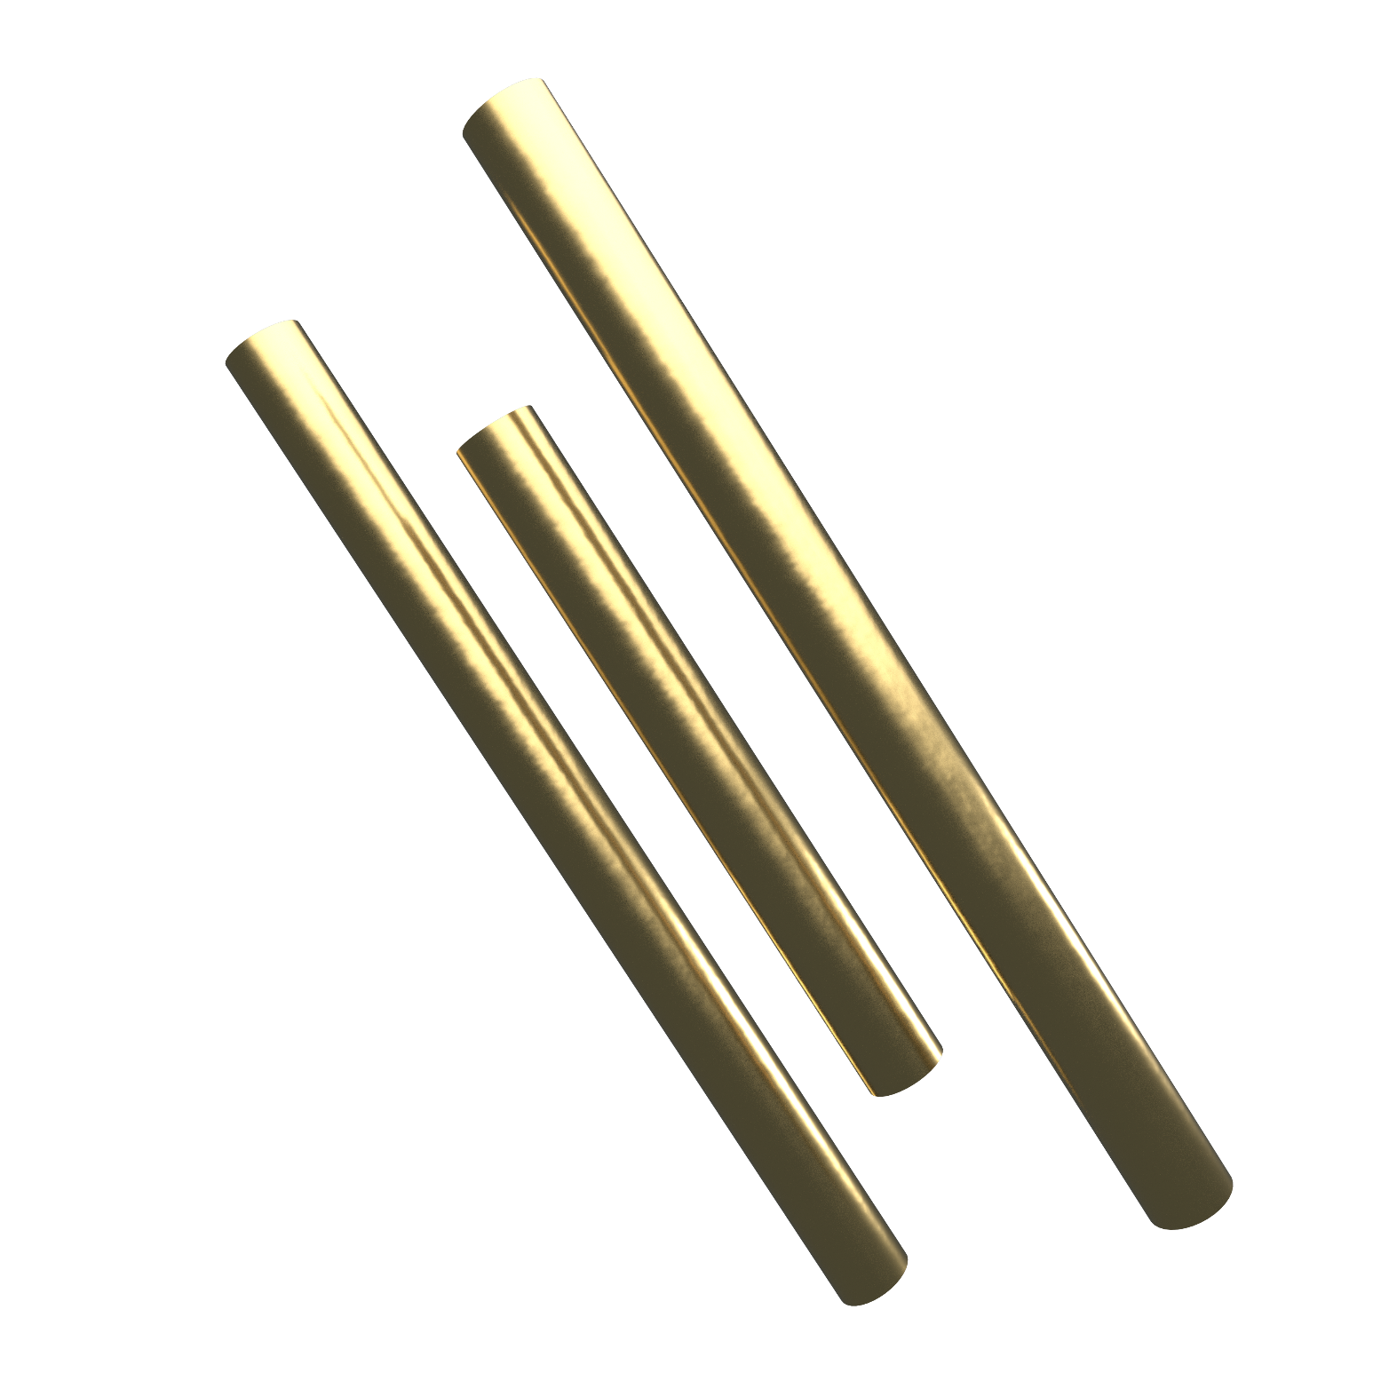

C ONTENTS
01
项目概述
02
项目创新点
03
项目执行情况和成果
04
结论与展望

Slide 3
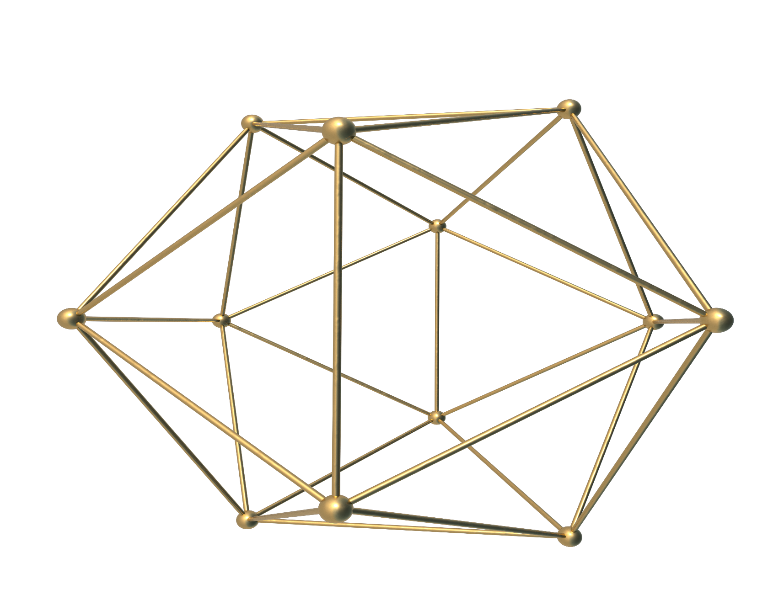
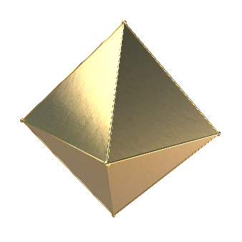
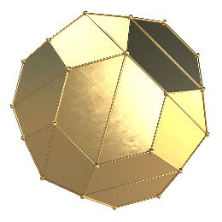
PART ONE
3D打印高氮钢技术
HIGH-RES 3D
GOLDEN SHAPE

Slide 4
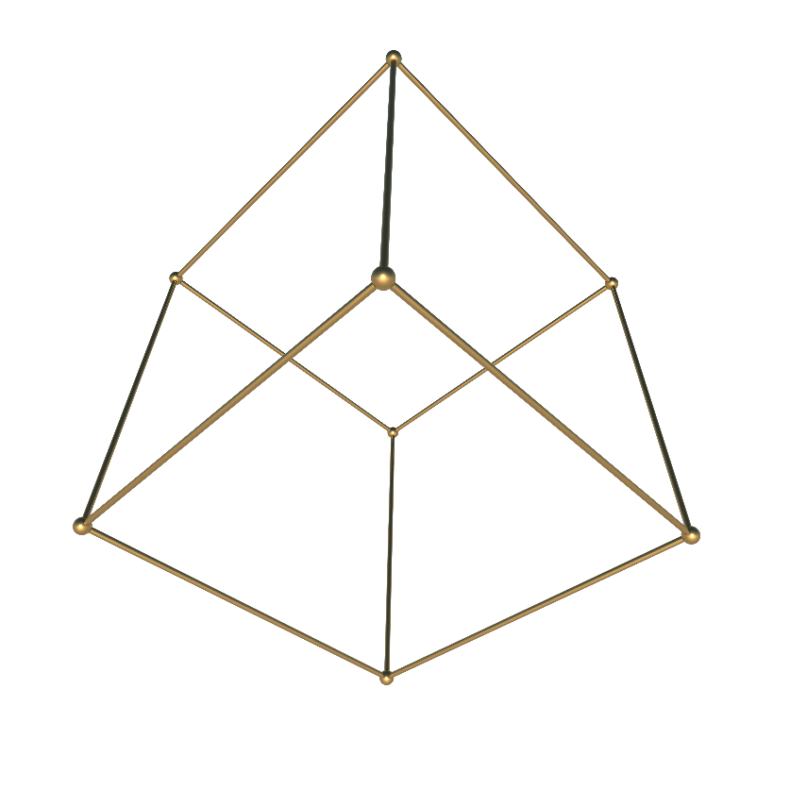
Creative Business
Upcoming Work Shop This Week
Title
August
18
Check Out
2018
For 30 Minutes
A wonderful serenity has taken possession of my entire soul, like these sweet mornings of spring which I enjoy with my whole heart.
@IBAOTU
@IBAOTU
@IBAOTU

Slide 5

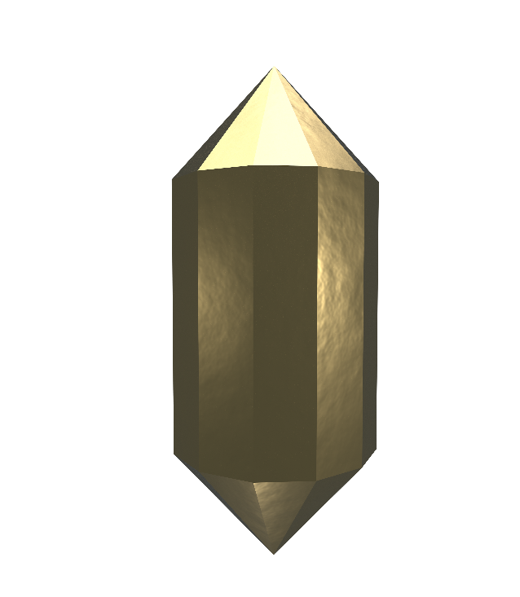
Creative Business
Better Think Better Smart
A wonderful serenity has taken possession of my entire soul, like these sweet mornings of spring which I enjoy with my whole heart. I am alone, and feel the charm of existence in this spot, which was created for the bliss of souls like mine.
1998 serenity has taken possession of my entire soul, like these sweet mornings

Slide 6
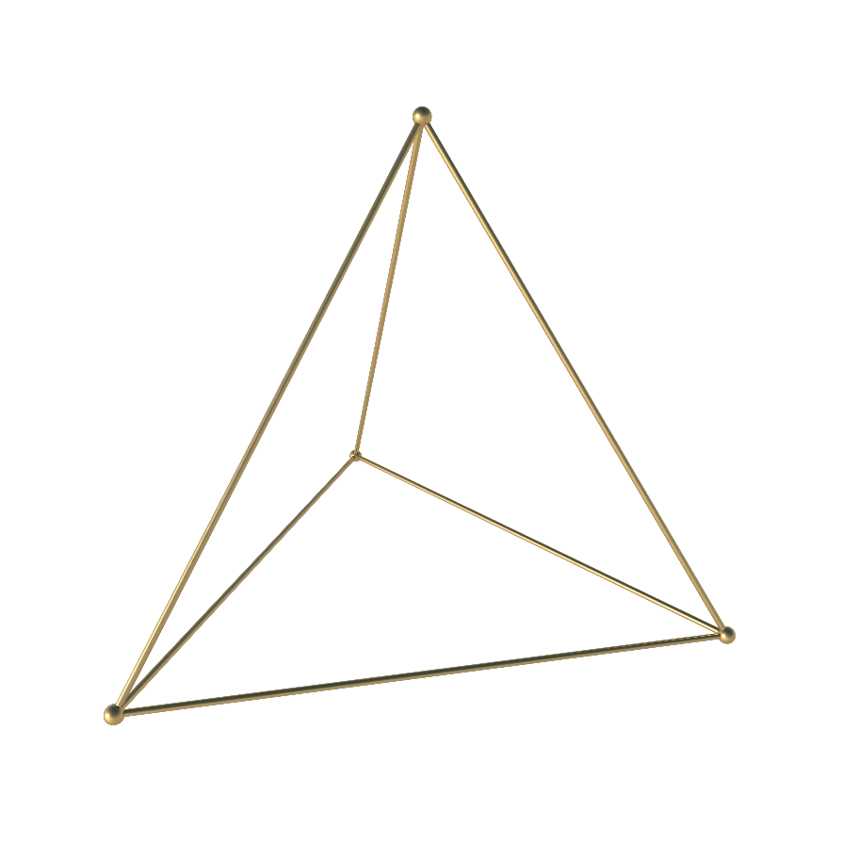

Breaking News
A wonderful serenity has taken possession of my entire soul, like these sweet mornings of spring which I enjoy
A wonderful serenity has taken possession of my entire soul, like these sweet mornings of spring which I enjoy
Better Think Better Smart
A wonderful serenity has taken possession of my entire soul, like these sweet mornings of spring which I enjoy with my whole heart. I am alone, and feel the charm of existence in this spot, which was created for the bliss of souls like mine. I am so happy, my dear friend, so absorbed in the exquisite sense of mere tranquil existence, that I neglect my talents.

Slide 7
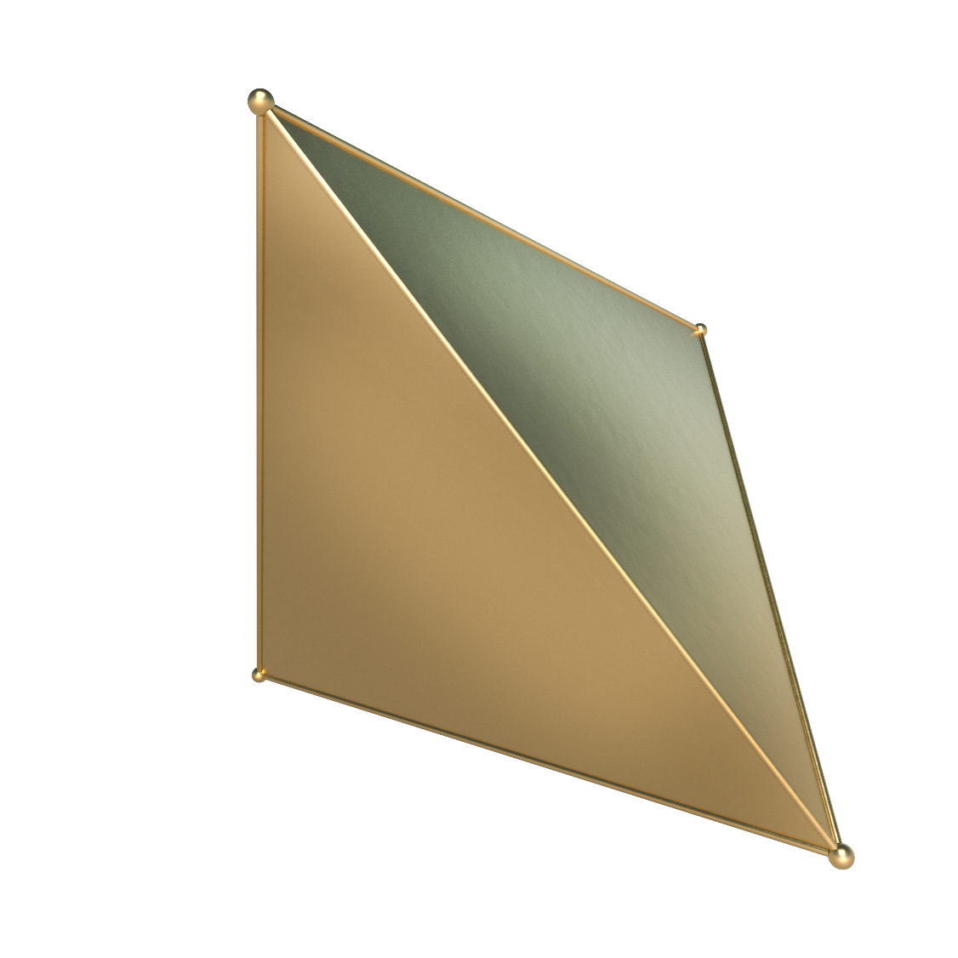
$56k
Our University
Your Text Goes Here
Better Think Better Smart
A wonderful serenity has taken possession of my entire soul, like these sweet mornings of spring which I enjoy
28%
Your Text Goes Here
A wonderful serenity has taken possession of my entire soul, like these sweet mornings
When, while the lovely valley teems with around me, and the meridian
A wonderful serenity has taken possession of my entire soul, like these sweet mornings of spring which I enjoy with my whole heart.

Slide 8
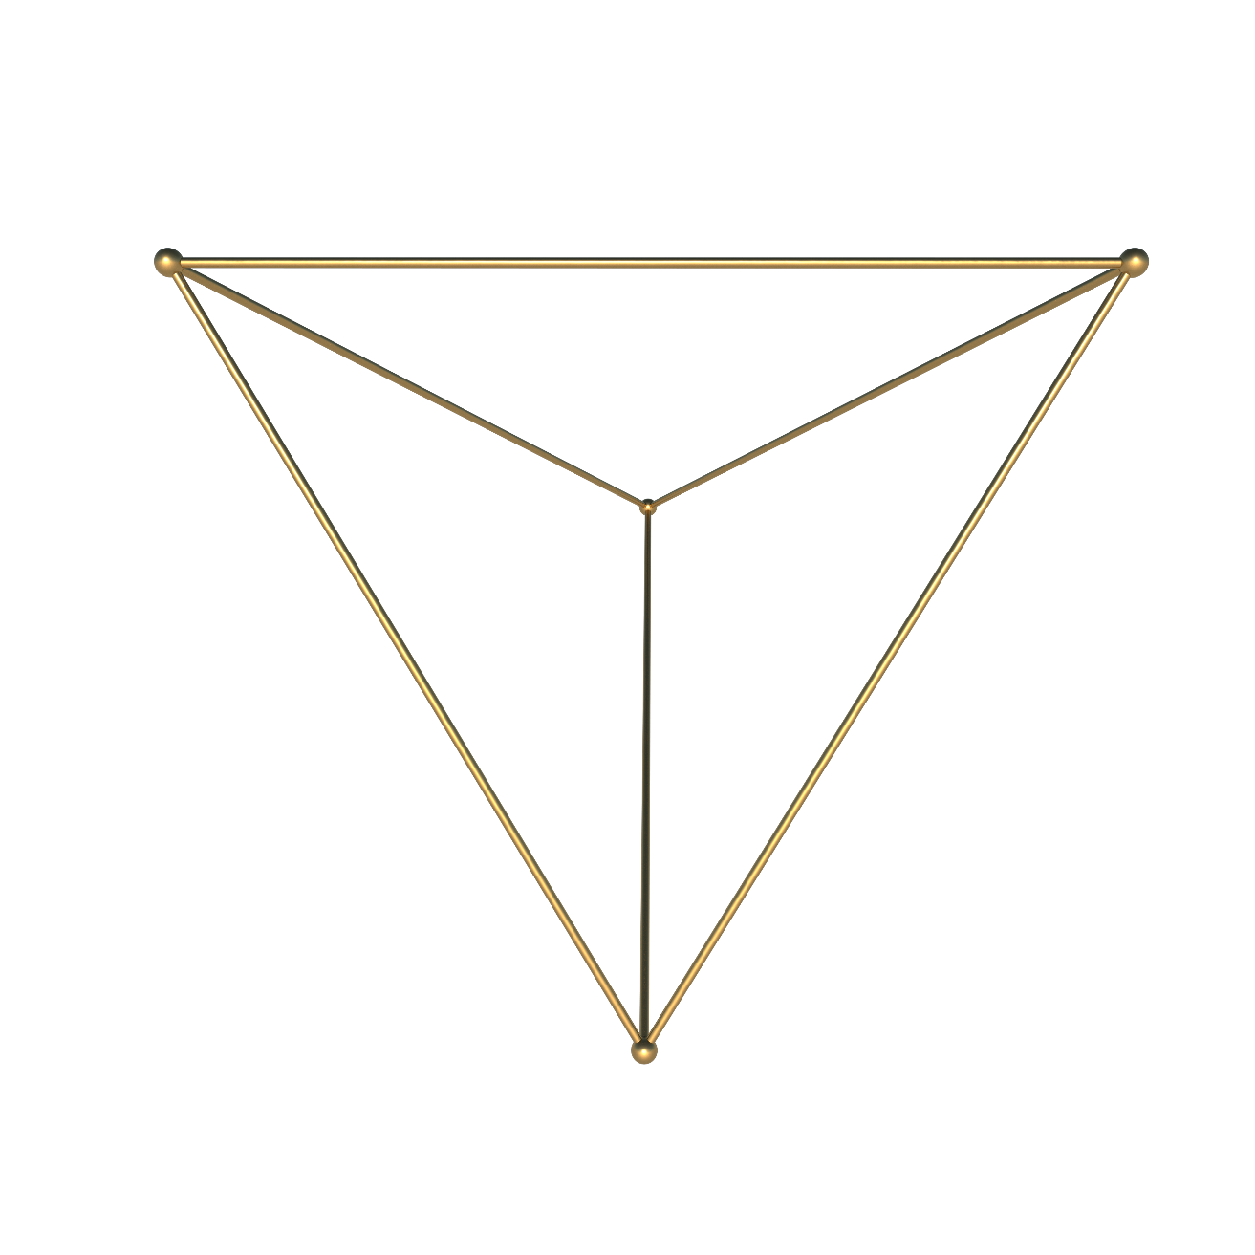

Designer
²⁰¹⁸
Creative Business
We Love Teamwork
Your Text Goes Here
A wonderful serenity has taken possession of my entire soul, like these sweet mornings
²⁰¹⁸
When, while the lovely valley teems with around me, and the meridian
Your Text Goes Here
A wonderful serenity has taken possession of my entire soul, like these sweet mornings of spring which I enjoy with my whole heart. I am alone, and feel the charm of existence in this spot, which was created for the bliss of souls like mine. I am so happy, my dear friend, so absorbed in the exquisite sense of mere tranquil existence, that I neglect my talents.
A wonderful serenity has taken possession of my entire soul, like these sweet mornings
GET STARTED NOW

Slide 9
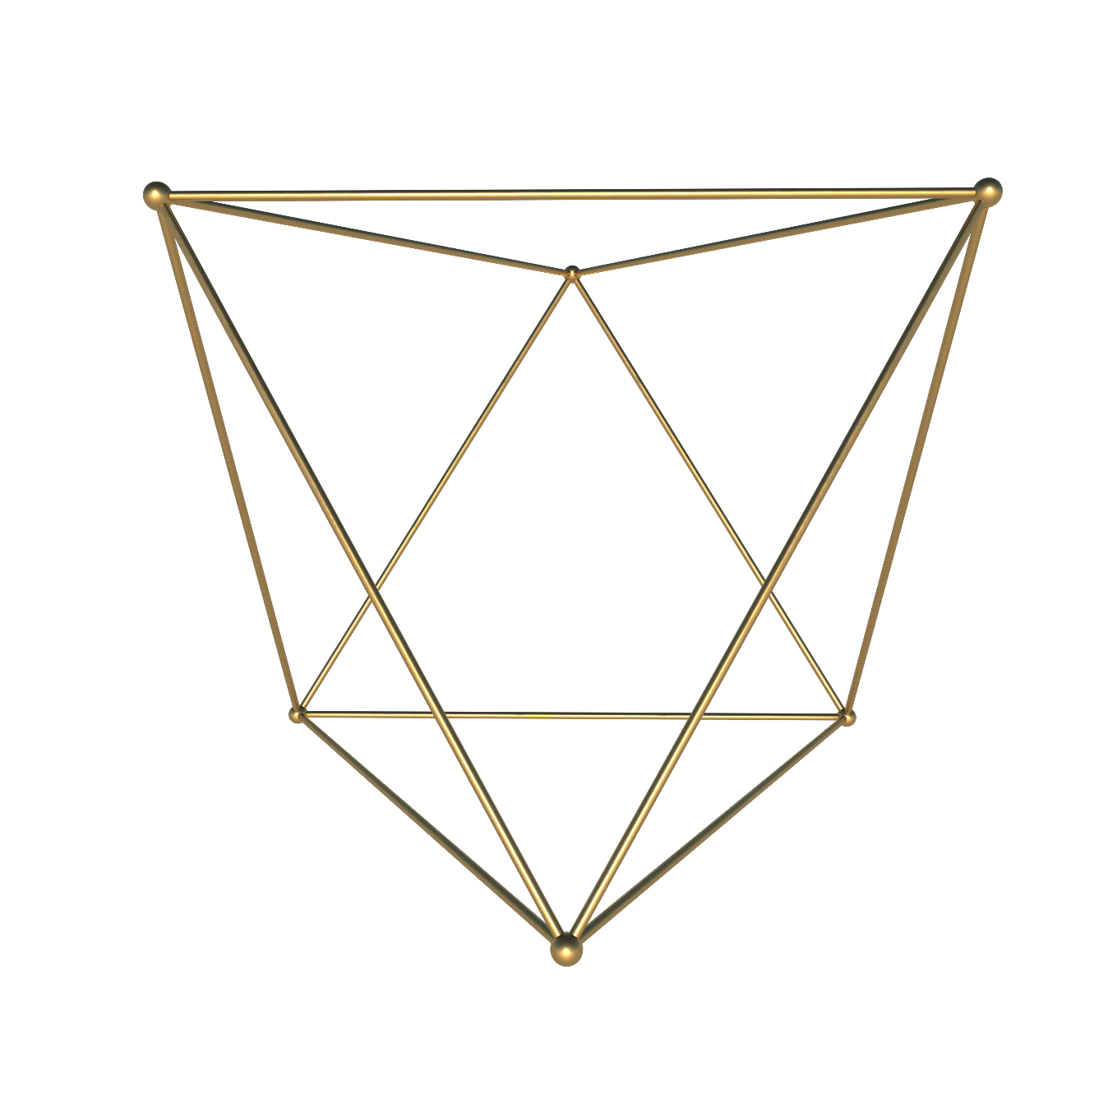

G LDART
P RT
TW
HIGH-RES 3D
GOLDEN SHAPE

Slide 10
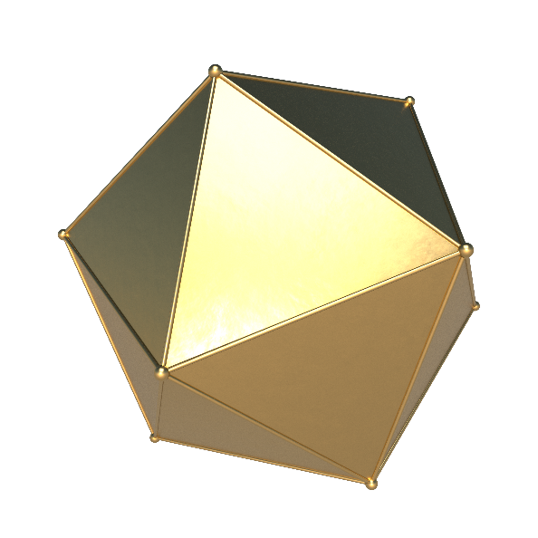
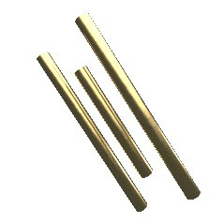
Creative Business
When, while the lovely valley teems with around me, and the meridian
New Package Open last Moon!
A wonderful serenity has taken possession of my entire soul, like these sweet mornings of spring which I enjoy with my whole heart. I am alone, and feel the charm of existence in this spot, which was created for the bliss of souls like mine. I am so happy, my dear friend, so absorbed in the exquisite sense of mere tranquil existence, that I neglect my talents.
Which Was Created For The Bliss Of Souls Like Mine. I Am So Happy, My Dear Friend.
$99/Day
A wonderful serenity has taken possession of my entire soul, like these sweet mornings of spring which I enjoy
GET STARTED NOW

Slide 11
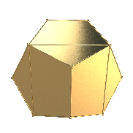
Our Partner
Graphic River
Themeforest
Photodune
Videohive
A wonderful serenity
A wonderful serenity
A wonderful serenity
A wonderful serenity
5678+
3908+
2009+
1267+
A wonderful serenity has taken possession of my entire soul
A wonderful serenity has taken possession of my entire soul
A wonderful serenity has taken possession of my entire soul
A wonderful serenity has taken possession of my entire soul

Slide 12


Creative Business
College Students
A wonderful serenity has taken possession of my entire soul, like these sweet mornings of spring which I enjoy with my whole heart. I am alone
Gender Classification
1500+
A wonderful serenity has taken possession of my entire soul, like these sweet mornings of spring which I enjoy
900+
A wonderful serenity has taken possession of my entire soul, like these sweet mornings of spring which I enjoy

Slide 13

Fresh Graduate
A wonderful serenity has taken possession of my entire soul, like these sweet mornings of spring which I enjoy with my whole heart. I am alone, and feel the charm of existence in this spot, which was created for the bliss of souls like mine.
90,1
Quis Nostrud exerci tation ullamcorper
A wonderful serenity has taken possession of my entire soul, like these sweet mornings of spring which I enjoy with my whole heart. I am alone, and feel the charm of existence in this spot, which was created for the bliss of souls like mine.

Slide 14


Education
A wonderful serenity has taken possession of my entire soul, like these sweet mornings of spring which I enjoy with my whole heart. I am alone, and feel the charm
Better Think Better Smart
OVERVIEW PICTURE
01
20 March 2018
02
20 March 2018
03
20 March 2018

Slide 15
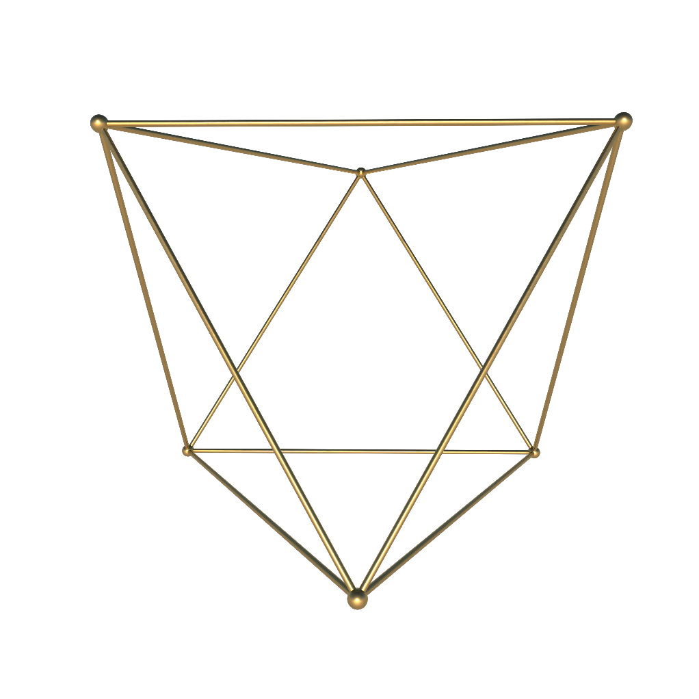



A wonderful serenity has taken possession of my entire soul, like these sweet mornings of spring which I enjoy with my whole heart.
Evelin- Design Communication
Creative Business
“A wonderful serenity has taken possession of my entire soul, like these sweet mornings of spring which I enjoy with my whole heart.
Students College Comment
Jonathan – Technology Information
A wonderful serenity has taken possession of my entire soul, like these sweet mornings of spring which I enjoy with my whole heart.
Lionel Wiz – Web Design

Slide 16


G LDART
P RT
T REE
HIGH-RES 3D
GOLDEN SHAPE

Slide 17
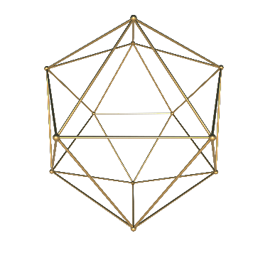

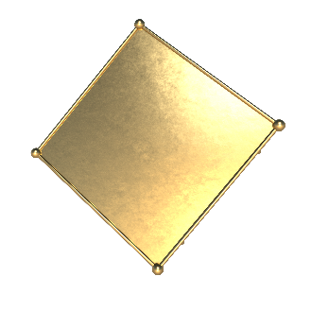

WHATCH, LEARN, CREATE.
#LetsDoIt
Story Of Success
Campus Life
Inspiring Person
A wonderful serenity has taken possession of my entire soul
A wonderful serenity has taken possession of my entire soul
A wonderful serenity has taken possession of my entire soul

Slide 18
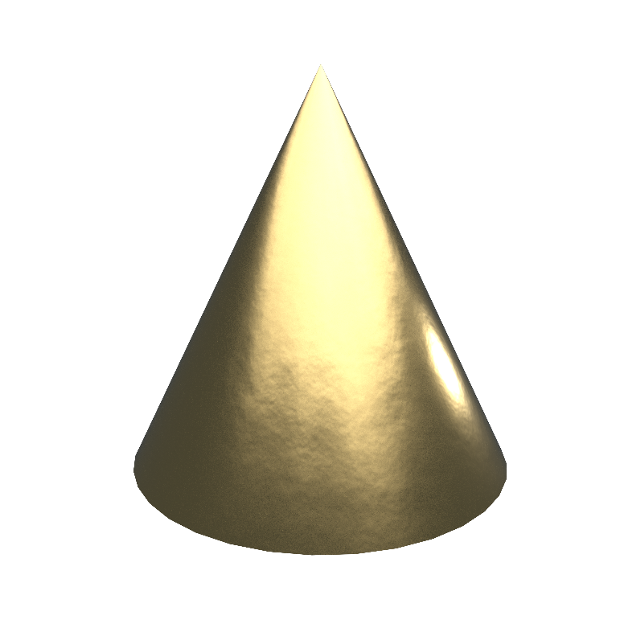
CAMPUS LIFE
When, while the lovely valley teems with around me, and the meridian
A wonderful serenity has taken possession of my entire soul, like these sweet mornings of spring which I enjoy with my whole heart. I am alone, and feel the charm of existence in this spot, which was created for the bliss of souls like mine. I am so happy, my dear friend, so absorbed in the exquisite sense of mere tranquil existence, that I neglect my talents.
#Campuslife
1500+
A wonderful serenity has taken possession of my entire soul, like these sweet mornings of spring which I enjoy
900+
A wonderful serenity has taken possession of my entire soul, like these sweet mornings of spring which I enjoy

Slide 19
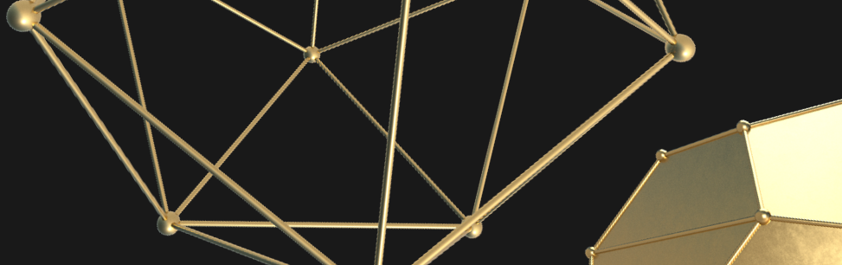
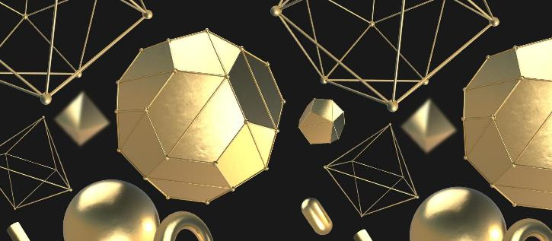
First Step
Second Step
A wonderful serenity has taken possession of my entire soul
A wonderful serenity has taken possession of my entire soul
Two Ways To Be Smart
A wonderful serenity has taken possession of my entire soul, like these sweet mornings of spring which I enjoy with my whole heart. I am alone, and feel the charm of existence in this spot

Slide 20
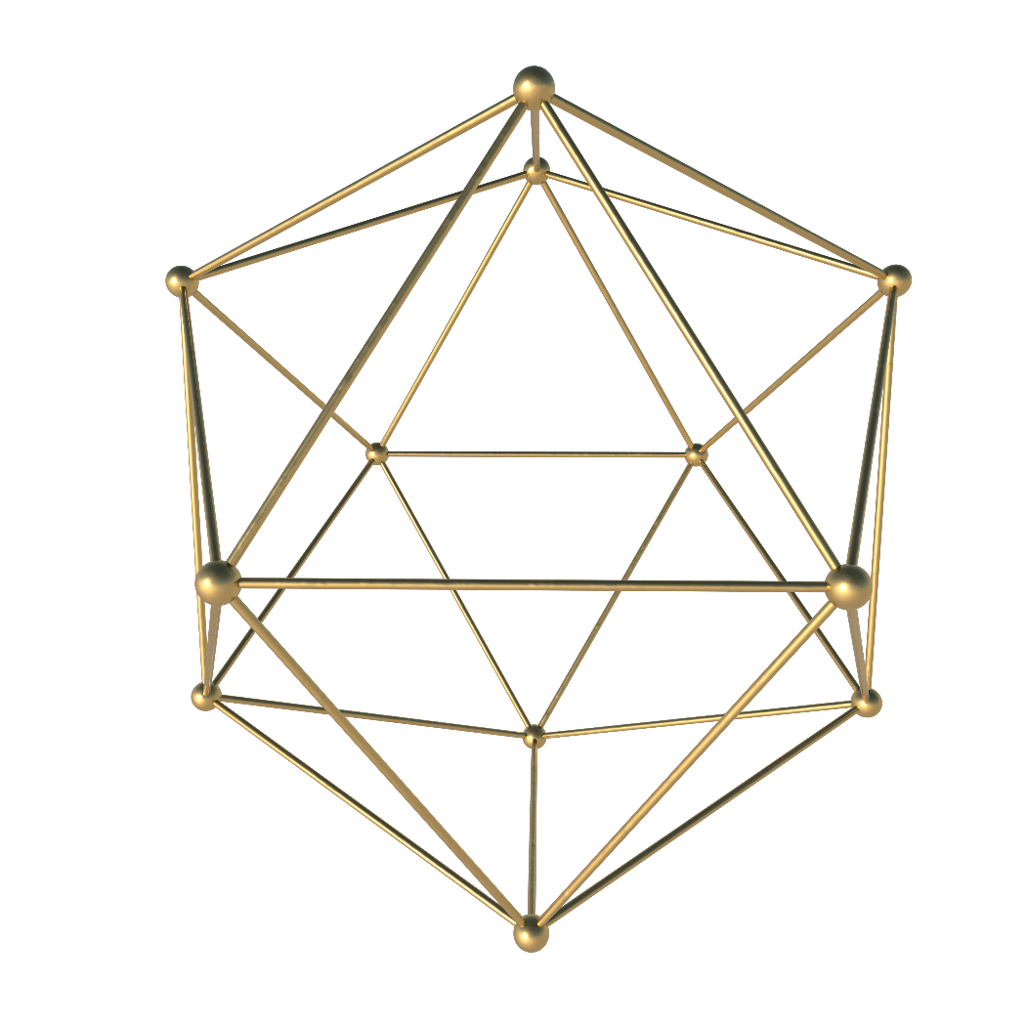
About Member
Team Working
A wonderful serenity has taken possession of my entire soul, like these sweet mornings of spring which I enjoy with my whole heart. I am alone, and feel the charm of existence in this spot, which was created for the bliss of souls like mine. I am so happy, my dear friend, so absorbed in the exquisite sense of mere tranquil existence.
A wonderful serenity has taken possession of my entire soul, like these sweet mornings of spring which I enjoy with my whole heart. I am alone, and feel the charm of existence in this spot, which was created for the bliss of souls like mine. I am so happy, my dear friend, so absorbed in the exquisite sense of mere tranquil existence.

Slide 21
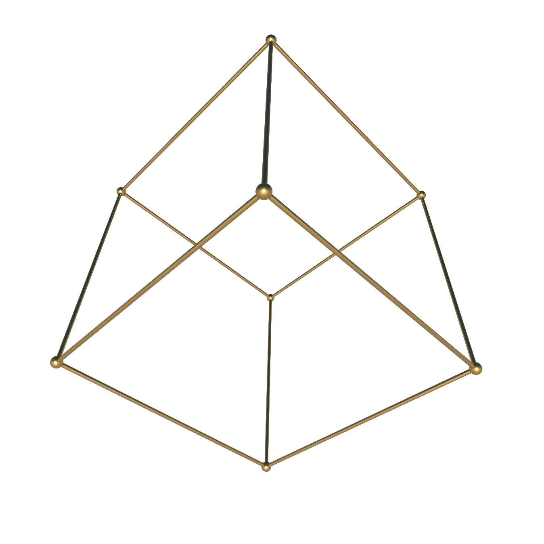

G LDART
P RT
F UR
HIGH-RES 3D
GOLDEN SHAPE

Slide 22

27 Sep 2017
Fresh Graduate
Networking
A wonderful serenity has taken possession of my entire soul, like these sweet mornings of spring which I enjoy with my whole heart.
A wonderful serenity has taken possession of my entire soul, like these sweet mornings of spring which I enjoy with my whole heart.
Important Point
Learn A Book
Creative Idea
A wonderful serenity has taken possession of my entire soul, like these sweet mornings of spring which I enjoy with my whole heart. I am alone, and feel the charm of existence in this spot, which was created for the bliss of souls like mine.
A wonderful serenity has taken possession of my entire soul, like these sweet mornings of spring which I enjoy with my whole heart.
A wonderful serenity has taken possession of my entire soul, like these sweet mornings of spring which I enjoy with my whole heart.

Slide 23
Creative Business
We Love Teamwork
When, while the lovely valley teems with around me, and the meridian
A wonderful serenity has taken possession of my entire soul, like these sweet mornings of spring which I enjoy with my whole heart. I am alone, and feel the charm of existence in this spot.
Your Title Here
Your Title Here
Your Title Here
Your Title Here
A wonderful serenity has taken possession of my entire soul
A wonderful serenity has taken possession of my entire soul
A wonderful serenity has taken possession of my entire soul
A wonderful serenity has taken possession of my entire soul

Slide 24
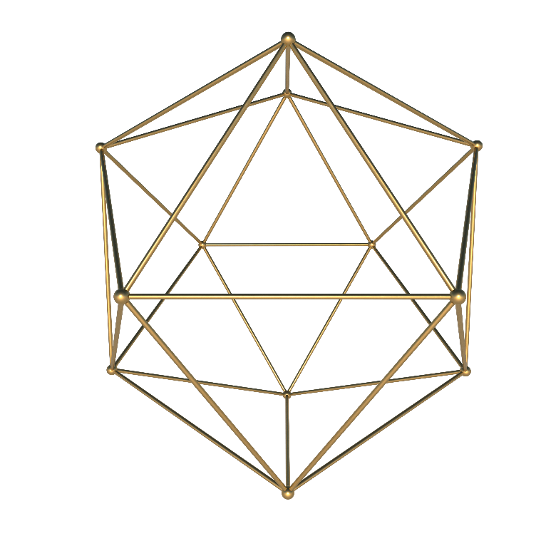
University
ANNOUNCEMENT
“A wonderful serenity has taken possession of my entire soul, like these sweet mornings of spring which I enjoy with my whole heart.
I am alone, and feel the charm of existence in this spot, which was created for the bliss of souls like mine. I am so happy, my dear friend, so absorbed in the exquisite sense of mere tranquil existence, that I neglect my talents.
User Name
@username
@username

Slide 25
Find Us On Social Media
A wonderful serenity has taken possession of my entire soul, like these sweet mornings of spring which I enjoy with my whole heart. I am alone, and feel the charm of existence in this spot, which was created for the bliss of souls like mine.
@IBAOTUllege
@IBAOTUllege
@IBAOTUllege

Slide 26
G LDART
THNAKYOU
| HIGH-RES 3D GOLDEN SHAPE

Slide 27
版权声明
感谢您下载包图网平台上提供的PPT作品，为了您和包图网以及原创作者的利益，请勿复制、传播、销售，否则将承担法律责任！包图网将对作品进行维权，按照传播下载次数进行十倍的索取赔偿！
1.在包图网出售的PPT模板是免版税类（RF：Royalty-Free）正版受《中国人民共和国著作法》和《世界版权公约》的保护，作品的所有权、版权和著作权归包图网所有，您下载的是PPT模板素材的使用权。
2.不得将包图网的PPT模板、PPT素材，本身用于再出售，或者出租、出借、转让、分销、发布或者作为礼物供他人使用，不得转授权、出卖、转让本协议或者本协议中的权利。
更多精品PPT模板：http://ibaotu.com/ppt/
点击进入

